Slide 1


Miami-Dade:
311 Requests & Crime Analysis
2017–2019 Analysis
LIS 4761 – Data/Text Mining
April 26, 2026
By: Zara Gonzalez, Johnny Nguyen, Elston Miller, Nicholas Alex, & Wesley Huang
Unsolved Mysteries
Notes:
Good Evening.
Our project, Miami-Dade: 311 Requests and Crime Analysis, examines data from 2017 to 2019 to explore relationships between service requests and crime patterns.
This was completed for LIS 4761: Data and Text Mining by our team.
We’ll briefly cover our data, methods, and key findings.

Slide 2

Contents
01. Introduction & Project Goal
02. Key Questions
03. Data Sources
04. Methodology Overview
05. Data Preparation
06. Analytics Methods
07. 311 Request Trends (2017-2019)
08. Most Common Complaint Types
09. Property Crime Trends
10. Complaints vs Crime Comparison
11. Complaint Themes
13. Practical Implications
14. Conclusion & Team Contributions
Notes:
Zara
Here’s a quick overview of our presentation.
We’ll start with our project goal and key questions, then introduce the datasets we used.
Next, we’ll walk through our methodology and data preparation process, followed by our analysis methods.
After that, we’ll present our results, including trends, comparisons, and text analysis.
Finally, we’ll summarize our key findings, discuss practical implications, and conclude with team contributions.

Slide 3

Project Goal
Miami Dade county analysis
Do citizen complaints reflect actual crime patterns?
Analyze trends in 311 service requests (2017–2019)
Compare complaint patterns with property crime data
Identify potential relationships between citizen reports and crime levels
Explore how public concerns reflect real-world crime trends
Notes:
Zara
For this project, our goal was to analyze patterns in 311 service requests across Miami-Dade County from 2017 to 2019.
We then compared these complaint patterns with property crime data from the same time period to see how they relate.
Specifically, we wanted to identify whether there is any relationship between what residents are reporting, like complaints or service requests, and actual crime levels.
Overall, this helps us better understand whether public concerns reflect real-world crime trends in the county.

Slide 4



Key Questions
How do 311 requests change in Miami-Dade County from 2017–2019?
What are the most common types of service requests?
How do property crime trends change over the same period?
Is there a relationship between 311 complaints and property crime trends?
Notes:
Johnny
We outlined the key questions guiding our analysis.
First, we wanted to understand how 311 service requests changed over time in Miami-Dade County between 2017 and 2019.
Next, we looked at the most common types of complaints to see what issues residents report most frequently.
We also analyzed how property crime trends changed over the same time period.
Finally, we explored whether there is any relationship between citizen complaints and crime trends, which is the main focus of our project.

Slide 5

Dataset: 311 Service Requests
Public Service Requests Dataset
Key Variables:
Source: Miami-Dade Open Data Portal
Years: 2017 – 2019
Size: ~320,000+ records per year (~960,000 total)
Type: Non-emergency service requests submitted by residents
issue_type – category of complaint
ticket_created_date_time – when request was submitted
zip_code / neighborhood_district – location of request
case_owner_description – text description (used for text mining)
Notes:
Johnny
This dataset comes from the Miami-Dade Open Data Portal and includes all 311 service requests submitted between 2017 and 2019.
Each year contains over 300,000 records, giving us nearly one million total observations to analyze.
These records represent requests submitted by residents for services like trash pickup, potholes, and other local issues.
For our analysis, we focused on key variables such as the type of complaint, when the request was created, the location, and the case description.
The case description is especially important because it allows us to perform text mining and identify common complaint themes.

Slide 6
Dataset: Property Crime
Official Crime Statistics Dataset
Key Variables:
Source: Florida Department of Law Enforcement (FDLE)
Years: 2017 – 2019
Level: County-level (Miami-Dade County)
Type: Reported property crime incidents
Burglary – unlawful entry offense
Larceny – theft without force
Motor Vehicle Theft – stolen vehicles
Total Property Crime – total reported incidents
Notes:
Wesley
This dataset comes from the Florida Department of Law Enforcement and covers property crime in Miami-Dade County from 2017 to 2019. Unlike the 311 data which shows what citizens were reporting, this one captures officially recorded crime incidents. We focused on four main categories — burglary, larceny, motor vehicle theft, and total property crime. Having this alongside the 311 data lets us see if what people were complaining about actually lines up with what was being reported as crime.

Slide 7
methodology & Analytical Approach
Exploratory Data Analysis (EDA)
Analyzed distribution of 311 complaints and property crime
Identified trends over time (2017–2019)
Visualization
Bar charts for most common complaints
Time-series analysis of 311 vs. crime trends
Comparative analysis between datasets
Text Mining
Word frequency analysis
TF-IDF to identify key complaint themes
Notes:
Wesley
For our analytical approach we used three main methods. First was exploratory data analysis — we looked at the distributions of both datasets, identified trends over time, and cleaned up anything that would've gotten in the way of the analysis. Second was visualization, where we used ggplot2 to build charts that made those trends actually readable. And third was text mining, where Nicholas applied word frequency and TF-IDF to the complaint descriptions to pull out the most common themes citizens were reporting. Together these three methods let us go from raw data to actual insights about the relationship between complaints and crime in Miami-Dade

Slide 8
Course Curriculum
Exploratory Data Analysis (EDA)
  Wk. 2 – Intro to data and Text Mining
  Ch. 12 – Pictures Versus Numbers
Visualization
  Ch. 12 – Pictures Versus Numbers
  Ch. 13 – Map Mashup
Text Mining
  Ch. 14 Word Perfect
  Wk. 6 - Intro to Text Analysis in R
  Ch. 15 - Happy Words?
Notes:
Wesley this slide is yours too
We applied several course methods including exploratory data analysis, time-series visualization, and comparative analysis.
This project pulled from a few different parts of the course. We used exploratory data analysis to understand our datasets before doing anything with them. We checked distributions, handling missing values, filtering down to what mattered. For visualization we used ggplot2 to build the charts and trend lines. And for text mining Nicholas applied word frequency and TF-IDF to pull themes out of the actual complaint text

Slide 9
Data Preparation
Loaded 311 service request files for 2017–2019
Replaced missing issue descriptions with blank text
Converted ticket date fields into date-time format
Created a year variable from ticket creation date
Combined yearly 311 files into one dataset
Filtered crime data to Miami-Dade County
Merged 311 totals with property crime data by year
Notes:
Johnny
We prepared the data in two parts.
First, we cleaned the 311 service request files by loading the 2017, 2018, and 2019 datasets, filling missing issue descriptions, converting date fields, and creating a year variable.
Then we combined the yearly files into one cleaned dataset.
For the crime data, we loaded the FDLE property crime files, filtered them to Miami-Dade County, selected the key property crime variables, and merged them with the 311 totals by year so the two datasets could be compared directly.

Slide 10
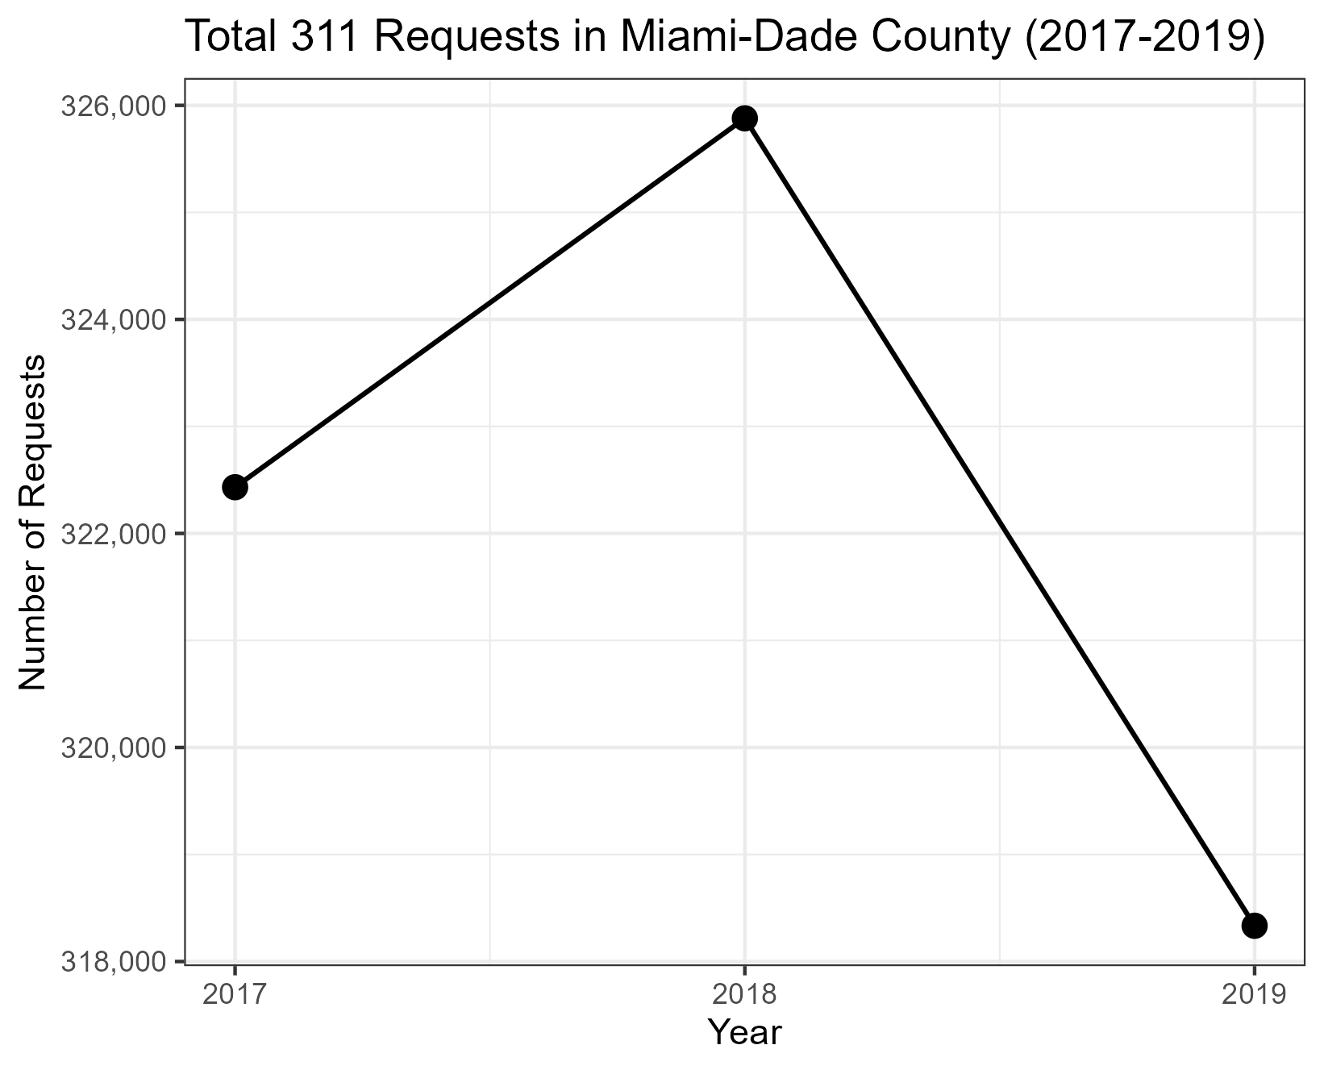
311 Requests trends
(2017-2019)
Requests increase from 2017 to 2018
Peak occurs in 2018
Noticeable decline in 2019
Overall: relatively stable demand
Notes:
Elston
This chart shows that 311 requests increased from 2017 to 2018 before declining in 2019.
Despite the drop, the overall demand remained relatively stable, indicating consistent demand for public services with at least 318 thousand requests each calendar year.

Slide 11
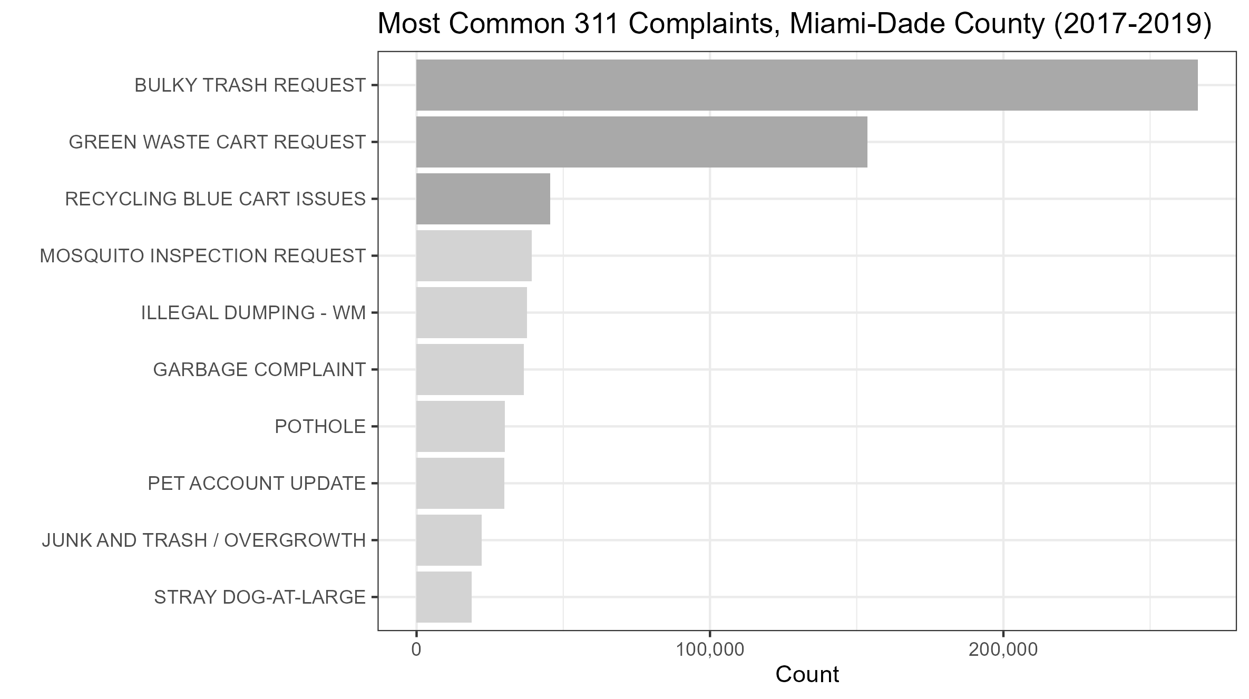
most common complaint types
Bulk trash requests dominate
Waste management-related complaints are most frequent
Infrastructure issues (potholes, dumping) also common
Complaints focus on quality-of-life issues
Notes:
Elston
We analyzed what issues prompted residents to call the 311 line most and found that by far the most common complaints were related to bulky trash and green waste cart issues. A common theme throughout this top chart is that most complaints are quality of life issues rather than crime related worries.

Slide 12
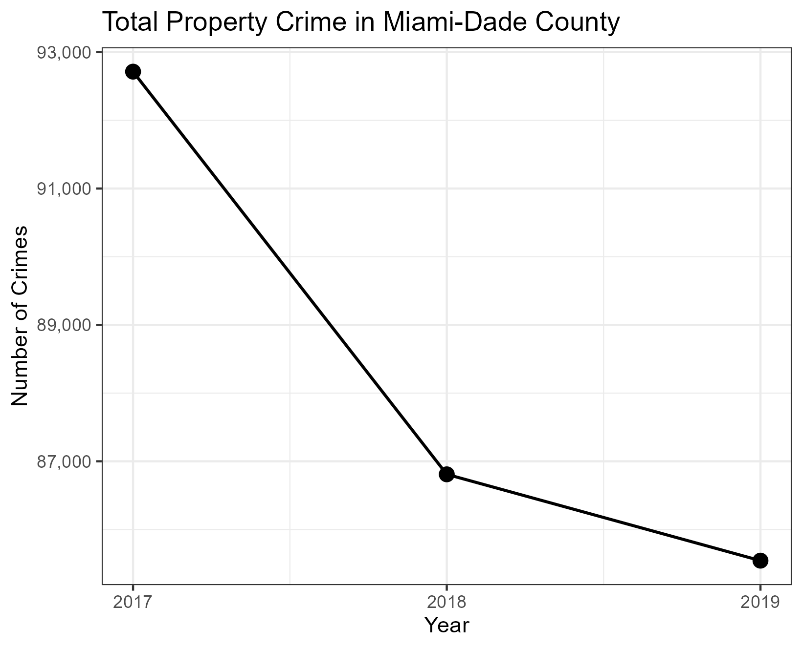
property crime trends
Property crime steadily decreases (2017–2019)
Largest drop between 2017 and 2018
Continued slight decline into 2019
Overall downward trend
Notes:
Elston
Moving into the crime data, the miami-dade county experienced a clear downward trend in property crime over that same period. The biggest drop happened between 2017 and 2018, that decline continued into 2019. This drop happened at the same time 311 requests remained relatively stable.

Slide 13
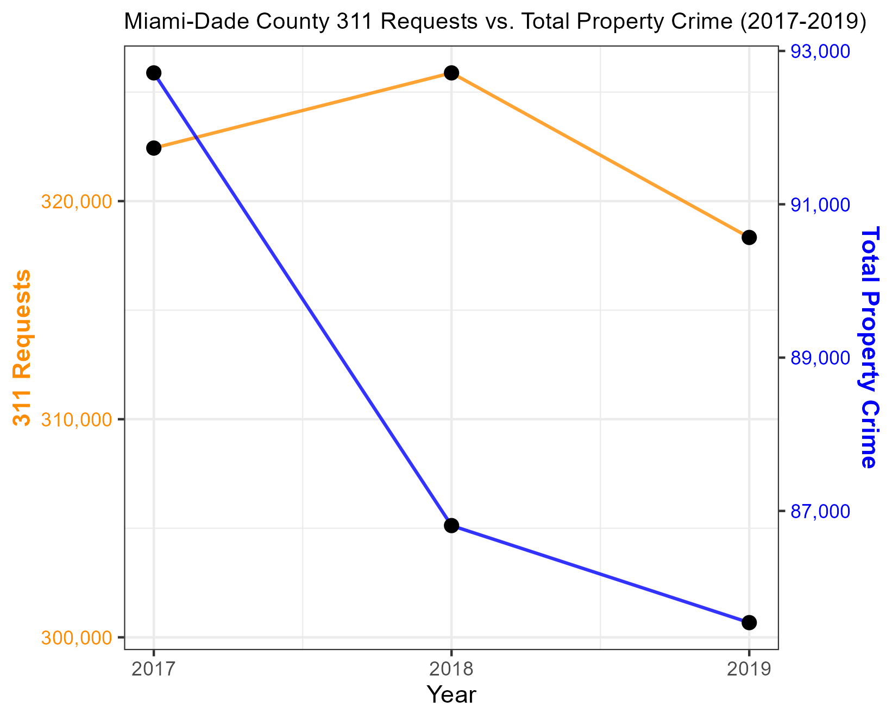
complaints vs crime comparison
311 requests remain relatively stable
Property crime declines over time
Trends do not move together
Suggests weak or indirect relationship
Notes:
Elston
Now we compare these two variables on the same chart. This chart takes the two variables and maps their trends into the same scale. It’s clear there’s no visual evidence in this chart to suggest these two variables move together. In 2018 when property crime declined by roughly 6 percent, 311 requests actually increased. These inconsistencies suggest that 311 requests and property crime have a weak or indirect relationship.

Slide 14
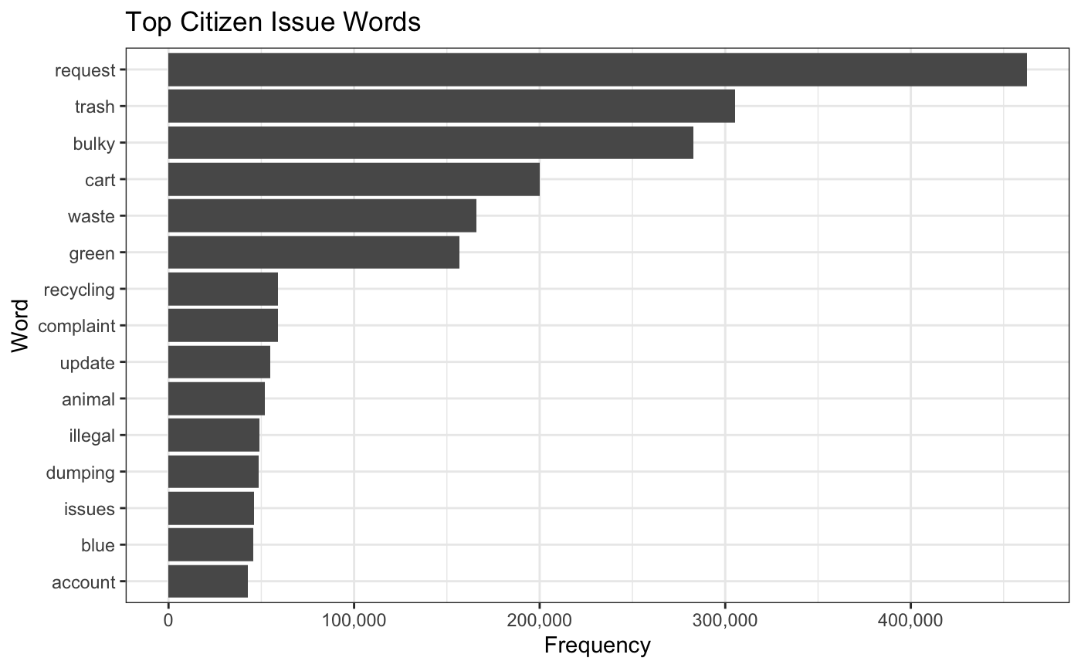
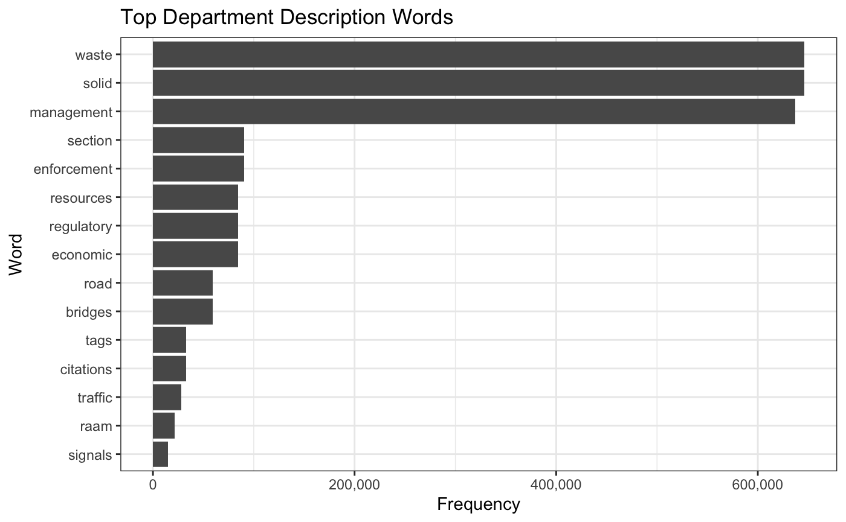
complaint themes
TEXT MINING
Word frequencies in both issue_type and case_owner_description columns
This helps compare how citizens express their issues vs how the department categorizes them.
h
Notes:
Nicholas
For the text mining portion of the project, we analyzed the issue type, which was how the complaints were filed by the citizens as well as the case owner descritpion, which is how the department categroized these complaints. The goal was to understand the most popular complaints expressed by citizens, and to analyze if these complaints related to crime, as well as how they changed over time. Finding the frequency of words used was done by tokenizing the text and removing common stop words to make sure only useful infromation was extracted out of the complaints. After the preparation of the data, we then created two bar graphs, one for each column, which show the highest frequency words that were used in the data. It is clear that many of the issues filed by citizens stem from utility issues as well as service disruptions. As for the department description words, most were related to waste management, as well as infrastructure like roads bridges and economy.

Slide 15
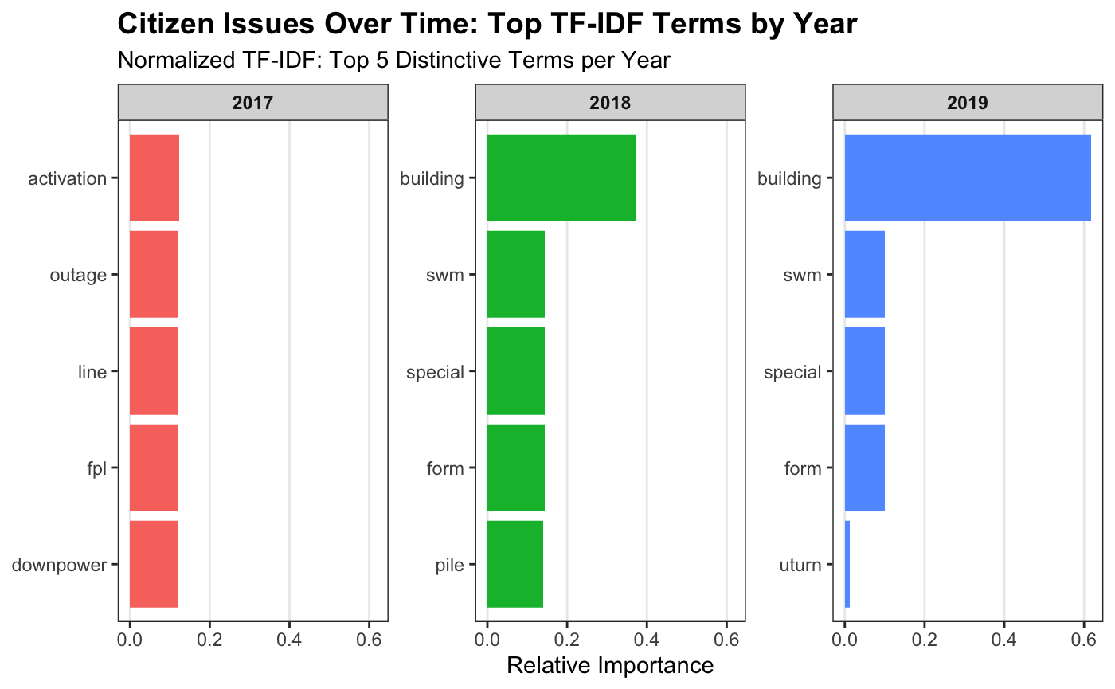
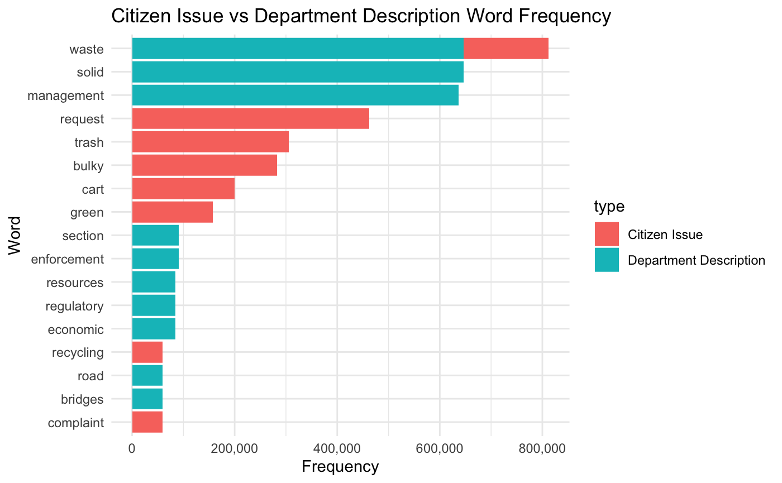
complaint themes
TF-IDF Time Based Comparison shows importance of words used throughout the three years of data.
Citizen Issue vs Department Description Word Frequency shows frequency of words used by both parties.
h
Notes:
Nicholas
The graph on the right is a TF-IDF time based comparison which shows the importance of words used throughout the three years. It is apparent that in 2017 most issues came from power –related events and most likely power outages. We can see that in 2018 and 2019, the TF IDF then shows that building was the most important word used in the complains by the citizens. As for the chart on the bottom, this shows the frequency of words used by both the citizens and the department, and shows that the word waste was not only the most commonly used word in total, but the only word that had major use implications for both parties. The broad pattern shows that most complaints, rather than related to crime, are related to moreso linked to infrastructure, utility, and service issues.

Slide 16
practical implications
311 data is useful for identifying community needs
Cities can use 311 data for service planning and resource allocation
Helps detect local issues before they escalate
Should NOT be used as a direct indicator of crime trends
Combining datasets gives a more complete picture of communities
Notes:
Zara
Based on our findings, there are a few key practical implications.
First, 311 data is useful for identifying real community needs, since it reflects what residents are actively reporting.
Second, cities can use this data to improve service planning and allocate resources more effectively.
It can also help identify problem areas early, allowing for quicker response.
However, 311 data should not be used as a direct measure of crime trends, since the two do not closely align.
Overall, combining 311 data with crime data gives a more complete picture of community conditions.

Slide 17
conclusion
Complaints and crime trends are related but not identical
Property crime shows a downward trend
Complaints more commonly focus on public service
Data provides insight into community behavior and safety
Notes:
Johnny
After comparing the two datasets side by side, we weren't able to find a strong relationship between 311 service requests and property crime trends. While crime decreased steadily from 2017 to 2019, 311 request volumes stayed relatively flat. This tells us that citizen complaints don't necessarily reflect what's happening with actual crime, people are reporting service issues regardless of whether crime is going up or down.

Slide 18

Elston Miller - Visuals
Zara Gonzalez – Project Manager
Research
Team
team contributions
Johnny Nguyen – Data Engineer
Nicholas Alex – Text Mining Analyst
Wesley Huang – Data Engineer
Notes:
Wesley
So just a quick overview of how we divided up the work and what everyones roles were. Zara was our project manager, she managed the whole project, kept everything organized, always reached out whenever we needed help and put together the final RMD file. Elston was our visualizations and reporting lead, he built all the visuals. Johnny was 1 of our data engineers. He handled the 311 data, loaded all three years, cleaned it up, and aggregated the request tools. I was the other data engineer. I worked on the crime data side, cleaned the FDLE files, filtering to Miami-Dade, and doing the final merge. And lastly, Nicholas was our text mining analyst. He ran the text mining on the complaint descriptions using word frequency and TF-IDF.

Slide 19
Thank you for
your attention
Notes:
Zara

